Slide 1

Hartland Township Resident Study
Supporting Decisions | Inspiring Ideas
October 2023

Slide 2
Background on Cobalt Community Research
501c3 not for profit research coalition
Mission to provide research and education
Developed to meet the research needs of schools, local governments and nonprofit organizations

Slide 3

Measuring where you are:
Why research matters
Understanding community values and priorities helps you plan and communicate more effectively about Township decisions
Understanding community perception helps you improve and promote the services and programs provided by the Township
Community engagement improves support for difficult decisions
Reliable data on community priorities aids in balancing demands of vocal groups with the reality of limited resources
Bottom line outcome measurement of service and trust: quality administration requires quality measurement and reporting

Slide 4
Study goals
Support budget and strategic planning decisions with additional community engagement
Ensure baseline service measures are monitored to support improvements and transparency
Identify which aspects of community provide the greatest leverage on residents’ overall satisfaction and outcomes such as remaining in the community and recommending the community to others
Understand results in context by benchmarking performance against statewide, regional and national indices that also measure industries and major organizations across the United States
Ensure the voices of various demographic groups are heard and appreciated

Slide 5
Bottom line
The Township outperformed many of the national, regional, and state benchmarks, but scores did soften since 2019
Areas most strongly linked with community satisfaction and engagement:
  Township Image
  Parks and Recreation
  Economic Health
  Local Government Management
69 percent support new fire station
66 percent support road millage renewal
The greatest support around residential trash and recycling is for large item pickup and keeping household costs the same; most use Dougie’s Disposal and Recycling

Slide 6
Bottom line
The majority of respondents are supportive of all public safety ideas with the greatest support for continuing LCSD services at the current level
The majority also are comfortable with ordinances and standards with the most concern for other planning (parking, lights, traffic, etc.) and properties in disrepair
Strongest funding priorities are road maintenance, law enforcement, and emergency medical services
Comment themes: Concerns about traffic and congestion, would like to see removal of vacant buildings, would like to see more food and retail businesses, and more affordable housing.

Slide 7
Methodology
Random sample of 2000 residents drawn from the voter registration list
Utilized www.random.org, a well-respected utility used internationally by many universities and researchers to generate true random numbers
Conducted using two mailings in September-October 2023. Residents had the option to respond online with unique ID number
Valid response from approximately 408 residents, providing +/- 4.75 percent margin of error with a confidence level of 95%
  Note: National surveys with a margin of error +/- 5% require a sample of 384 responses to reflect a population of 330,000,000

Slide 8
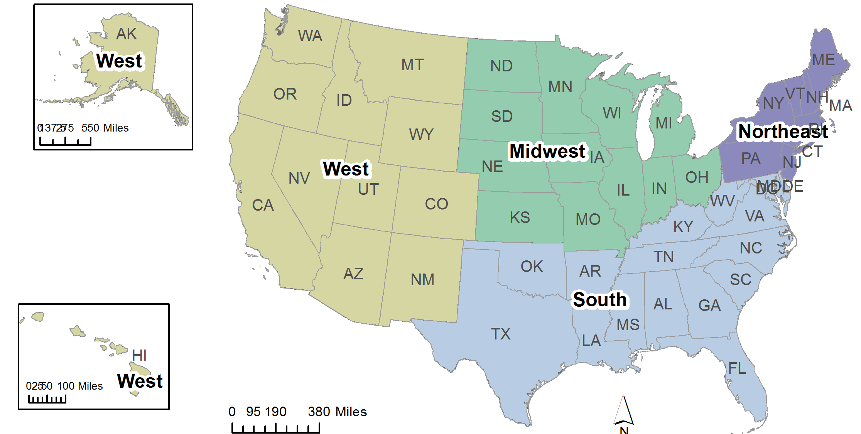
Available Tools
Comparison scores with local governments in Michigan, the Midwest and across the nation
Comparison scores with non-local government comparables (industries, companies, federal agencies) at www.theacsi.org
Detailed questions and responses broken by demographic group and “thermal mapped,” so lower scores are red and higher scores are blue

Slide 9
Preserving Voice: Looking Into Detail
Checkered Scores that Vary by Demographics
Consistent Scores Regardless of Demographics

Slide 10
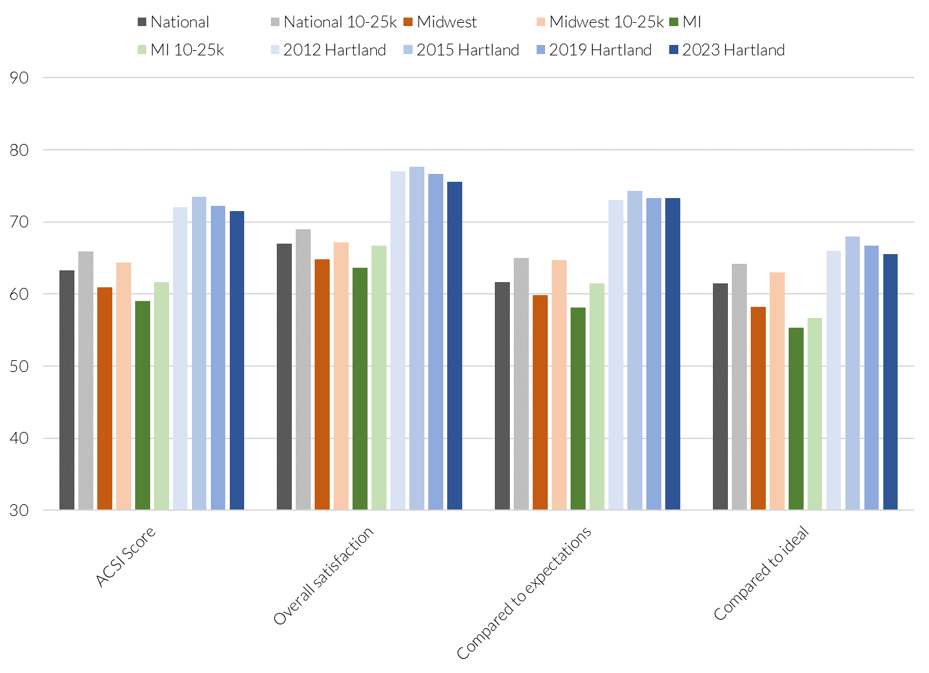
Overall ACSI Scores in Context

Slide 11
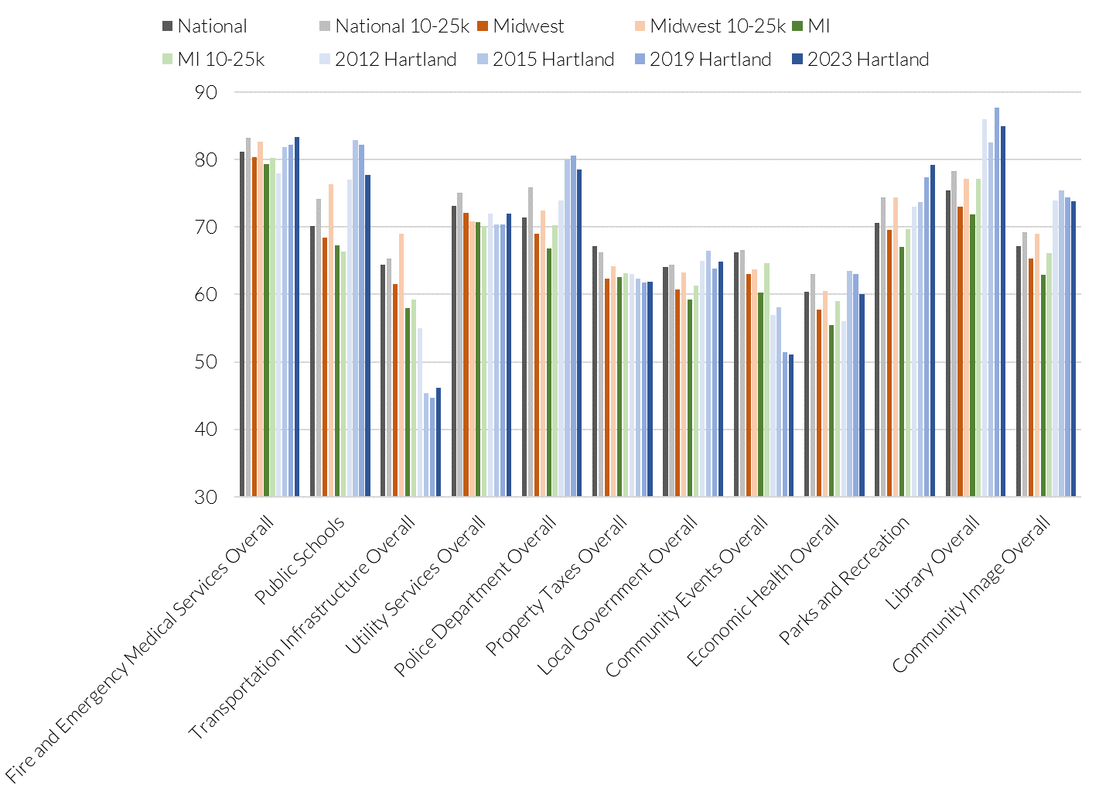
Overall Experiences in Context

Slide 12
Understanding the Charts:
Community Questions – Long-term Drivers
High scoring areas that do not currently have a strong relationship to engagement relative to the other areas. | Areas where the organization received high scores and that have a strong relationship to engagement. Strengths to build on.
Lower scoring areas relative to the other areas with low relationship to engagement. | Areas where the organization received lower scores and that have a strong relationship to engagement. Weaknesses to improve.
Perceived Performance
Strength of Relationship

Slide 13
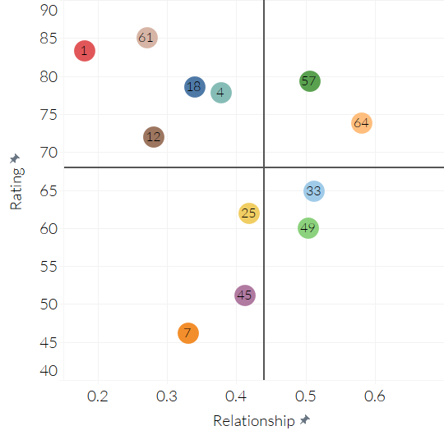
Drivers of Satisfaction and Behavior:
Strategic Priorities
Higher Connection,
Higher Satisfaction
Higher Connection,
Lower Satisfaction

Slide 14

Results

Slide 15
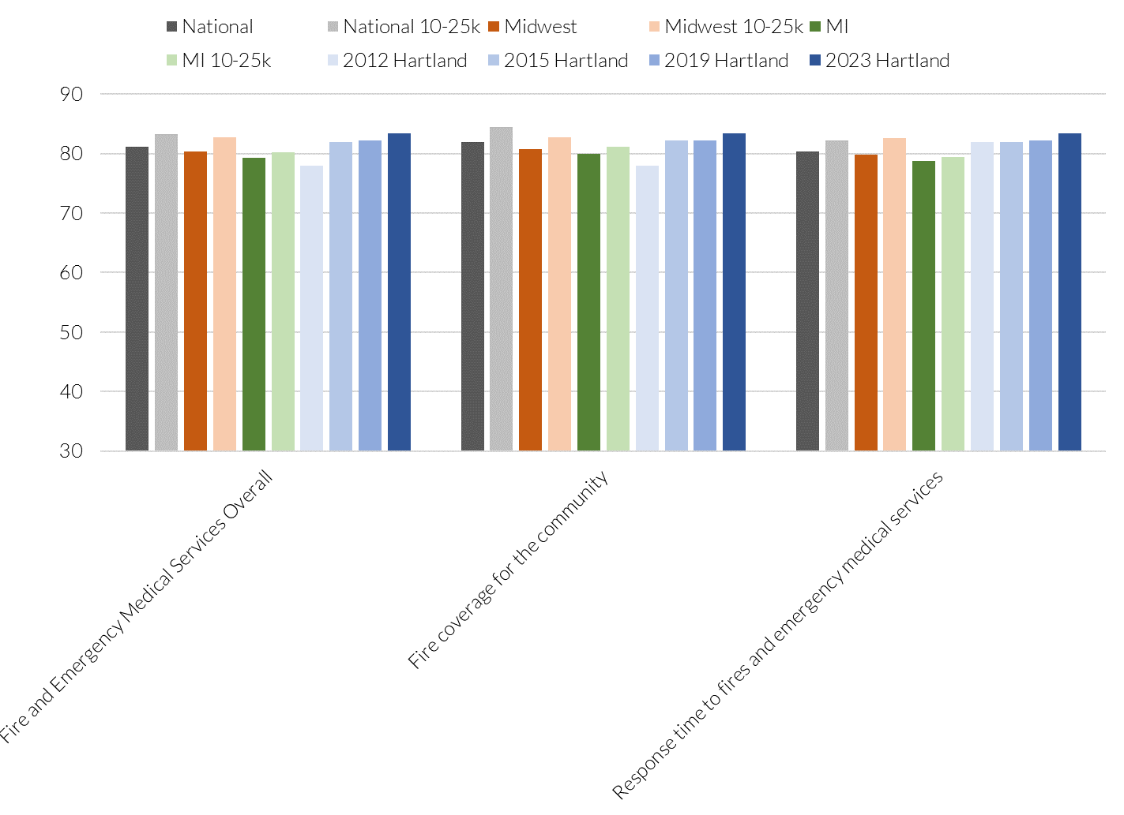
Hartland's fire and emergency medical services

Slide 16
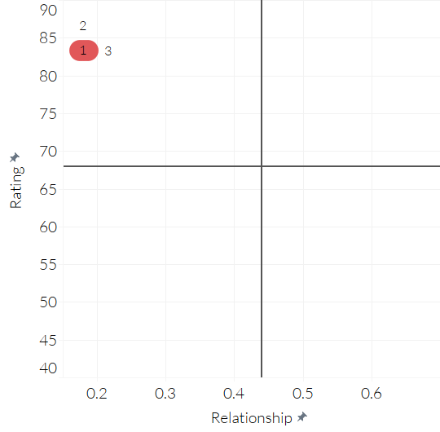
Drivers of Satisfaction and Behavior:
Fire/EMS
Higher Connection,
Higher Satisfaction
Higher Connection,
Lower Satisfaction

Slide 17
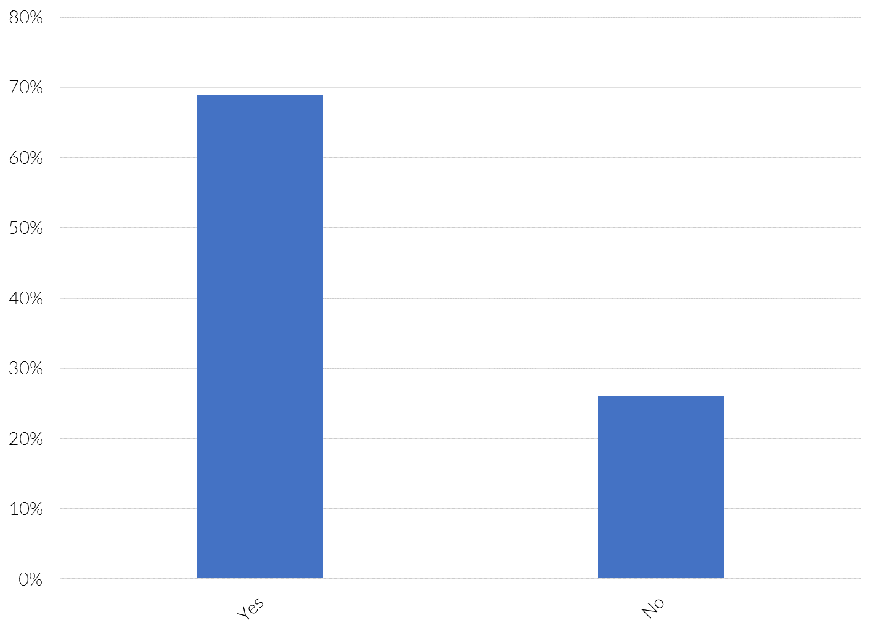
Question 2: Do you support millage for a new fire station?

Slide 18
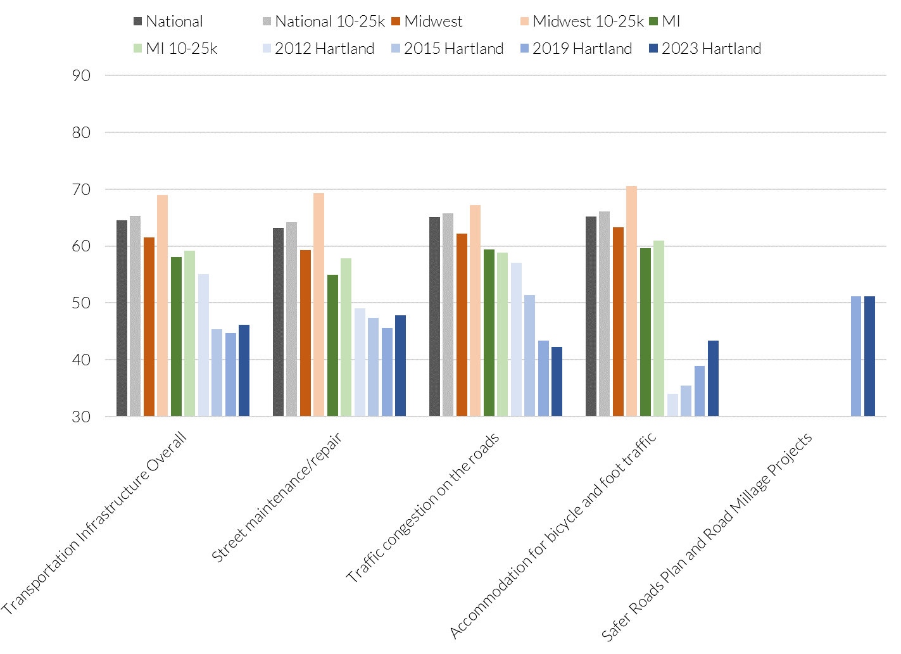
Transportation Infrastructure

Slide 19
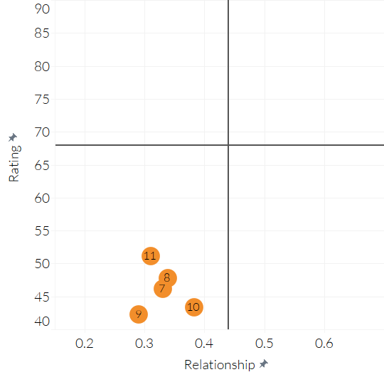
Drivers of Satisfaction and Behavior:
Transportation
Higher Connection,
Higher Satisfaction
Higher Connection,
Lower Satisfaction

Slide 20
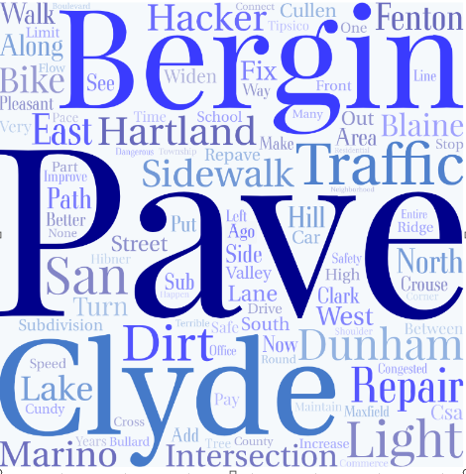
Question 5: Which transportation/street repair projects would you like to see prioritized in the coming years?
Top themes:
1- Pave- Residents would like dirt roads to be paved and existing paved roads to be repaired
2- Bergin- This is a road residents would like to see paved
3- Clyde- This is also a road residents would like to have paved

Slide 21
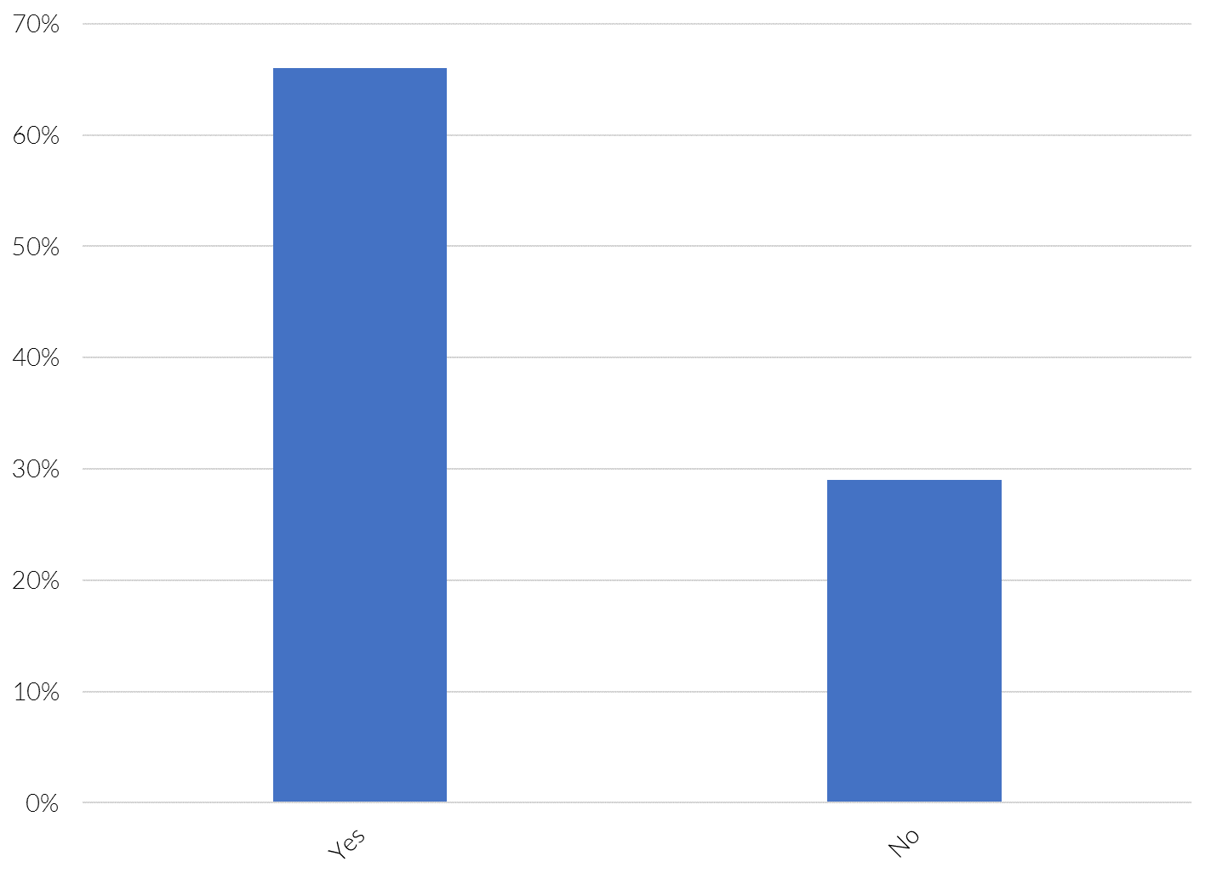
Question 6: Do you support millage renewal?

Slide 22
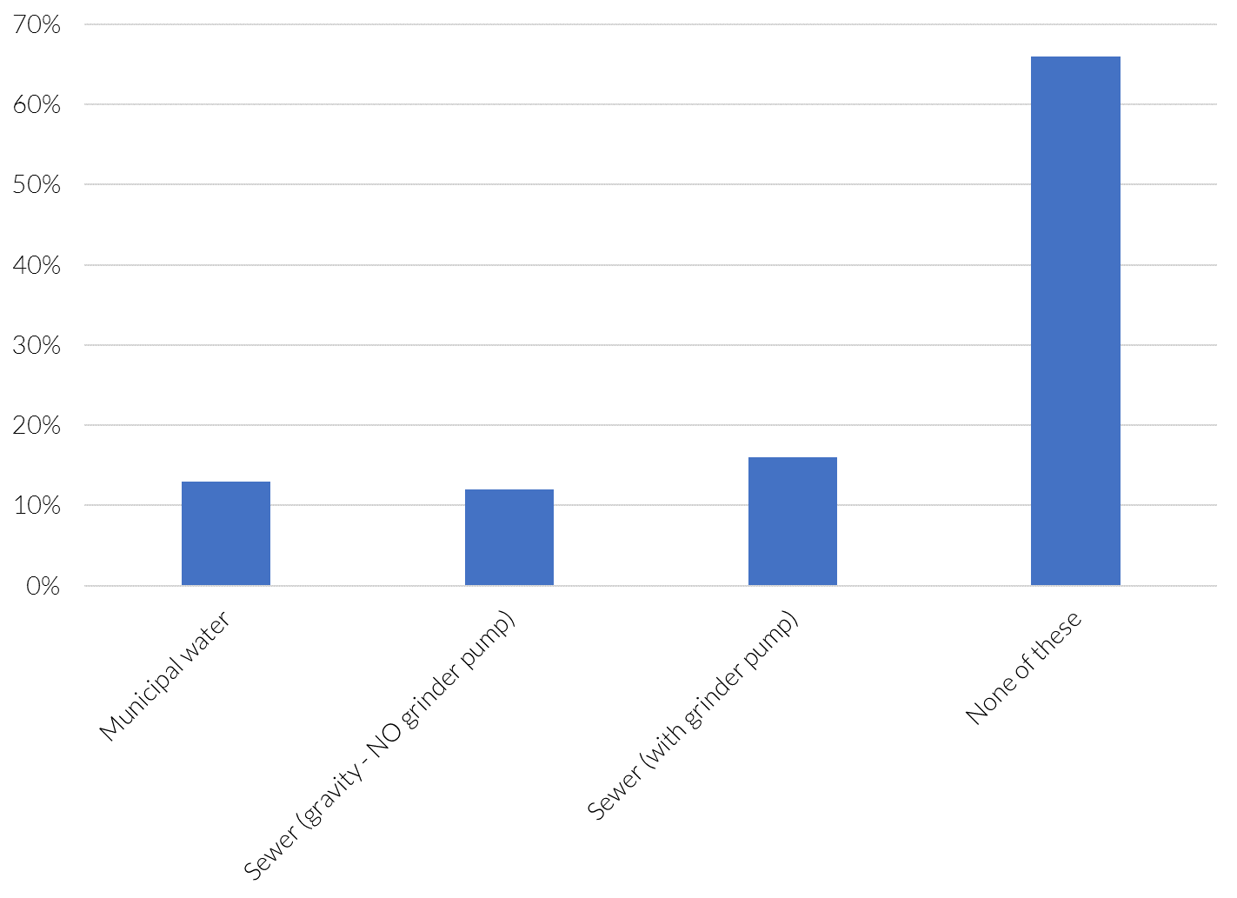
Question 7: Which utility services do you receive?

Slide 23
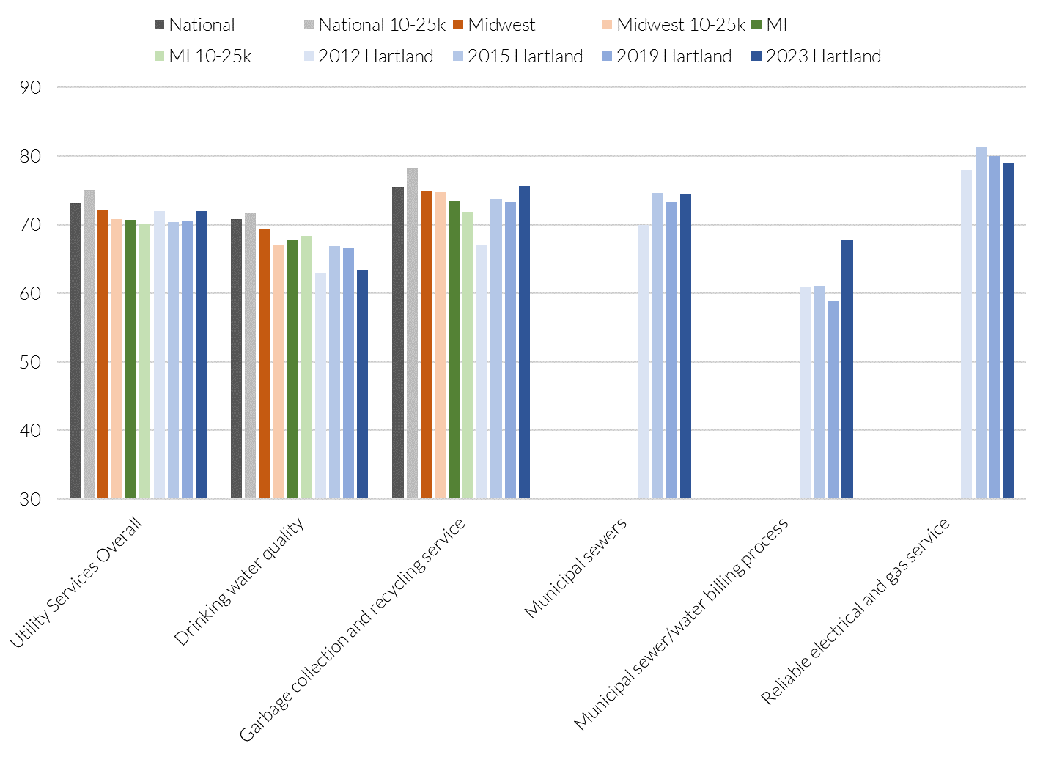
Utility Services

Slide 24
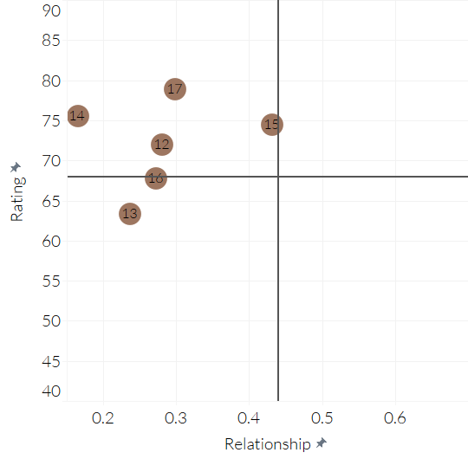
Drivers of Satisfaction and Behavior:
Utility Services
Higher Connection,
Higher Satisfaction
Higher Connection,
Lower Satisfaction

Slide 25
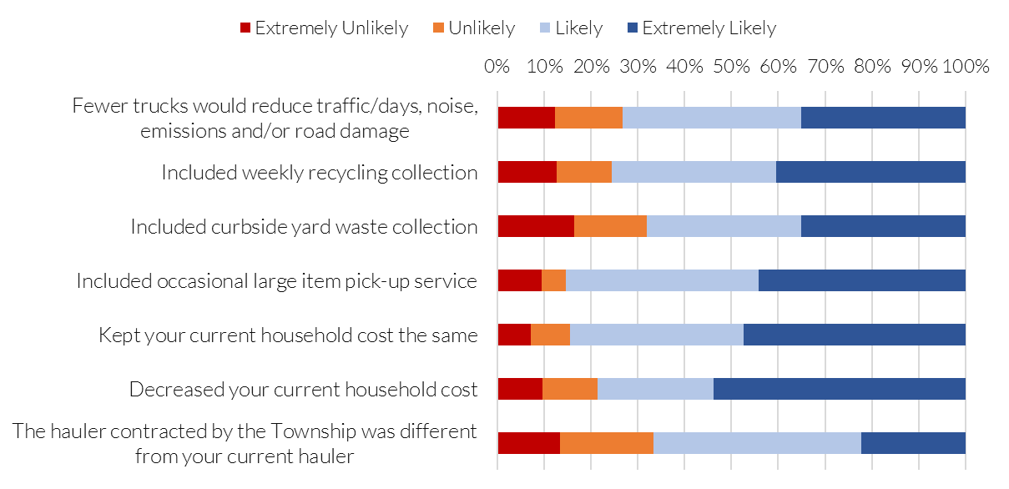
Question 9: Change in residential trash and recycling service support

Slide 26
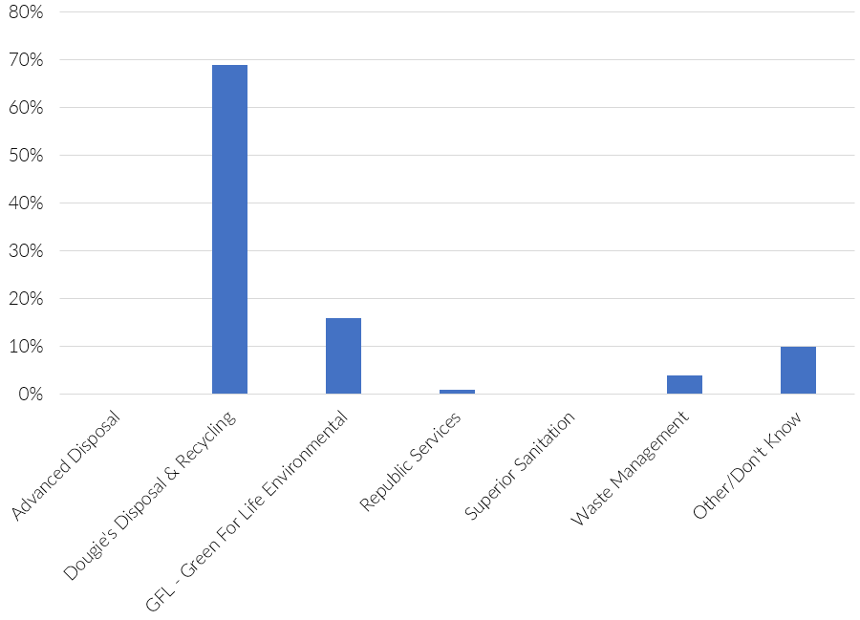
Question 10: Which trash provider do you use?

Slide 27
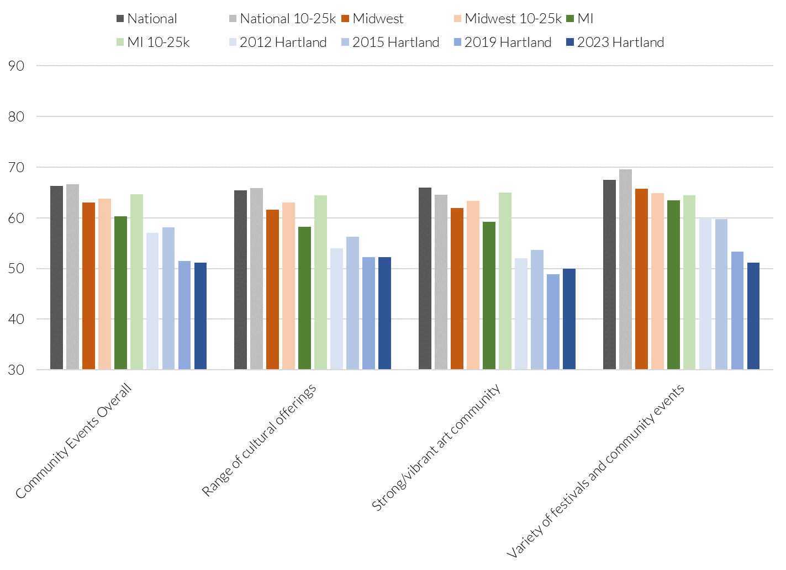
Community Arts, Culture, and Events

Slide 28
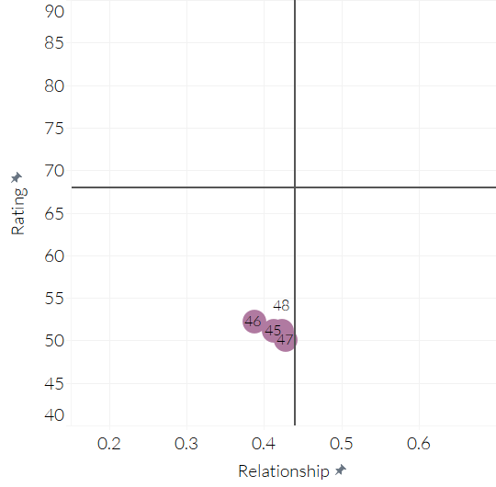
Drivers of Satisfaction and Behavior:
Community Arts, Culture, and Events
Higher Connection,
Higher Satisfaction
Higher Connection,
Lower Satisfaction

Slide 29
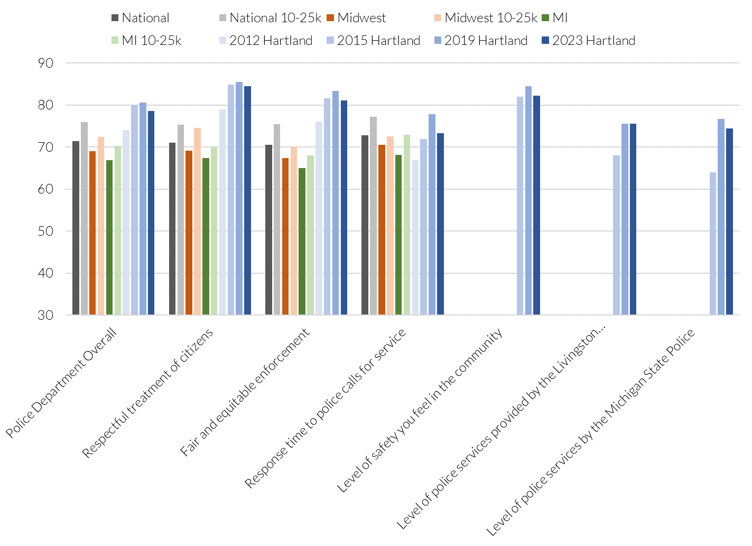
Police Services

Slide 30
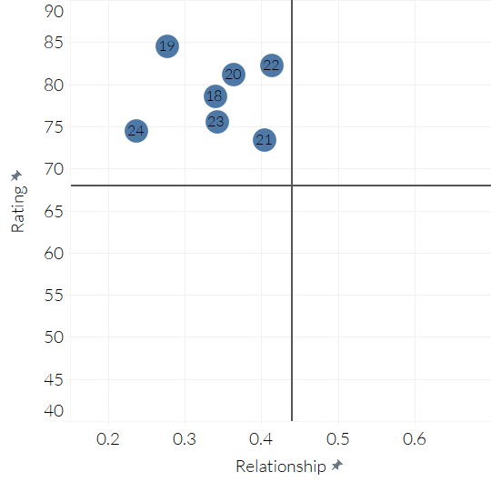
Drivers of Satisfaction and Behavior:
Police Services
Higher Connection,
Higher Satisfaction
Higher Connection,
Lower Satisfaction

Slide 31
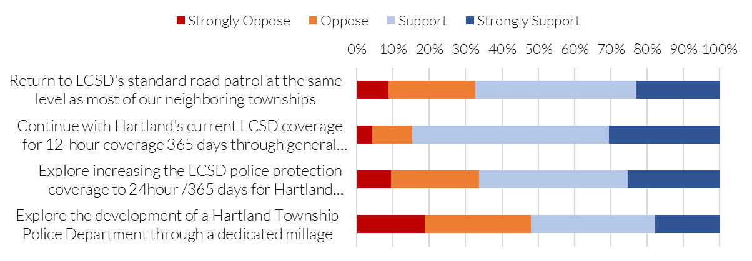
Question 13: Level of support for public safety options.

Slide 32
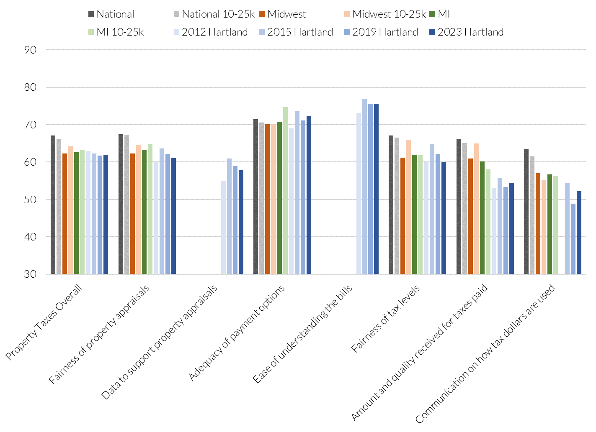
Local Property Taxes

Slide 33
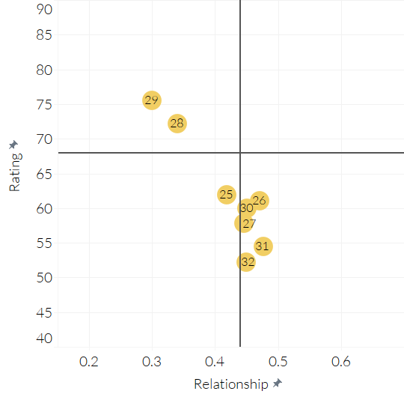
Drivers of Satisfaction and Behavior:
Local Property Taxes
Higher Connection,
Higher Satisfaction
Higher Connection,
Lower Satisfaction

Slide 34
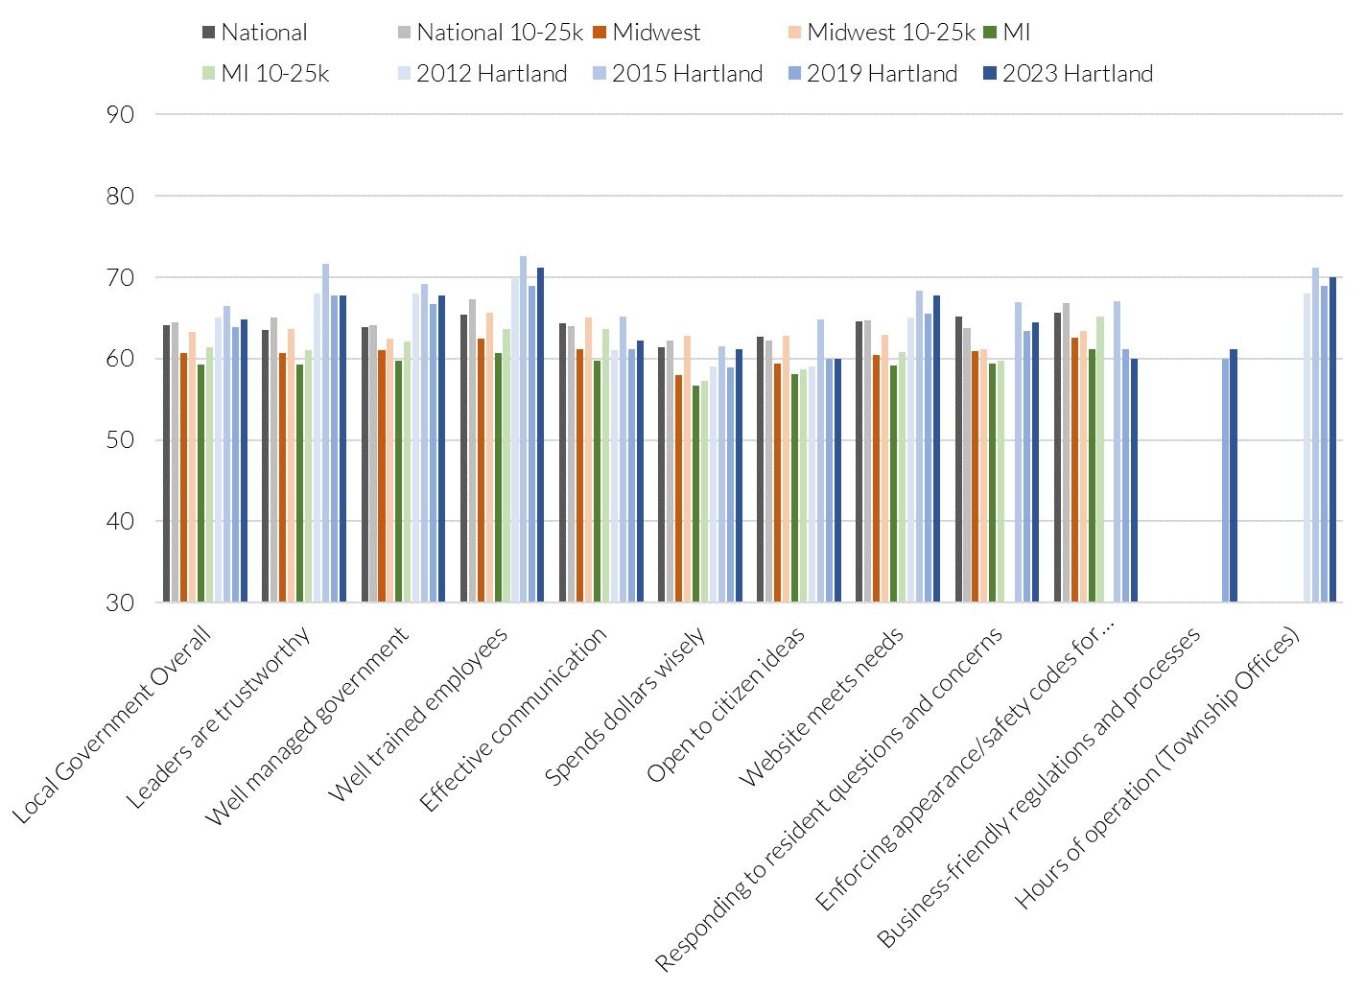
Hartland Township Government

Slide 35
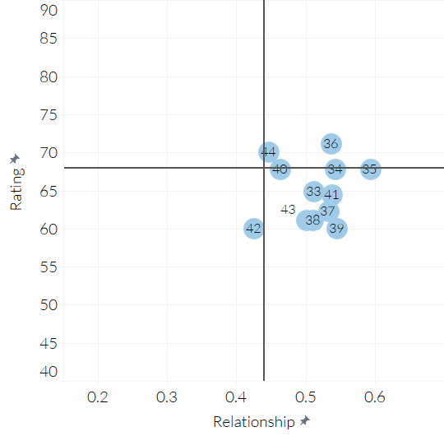
Drivers of Satisfaction and Behavior:
Local Government Overall
Higher Connection,
Higher Satisfaction
Higher Connection,
Lower Satisfaction

Slide 36
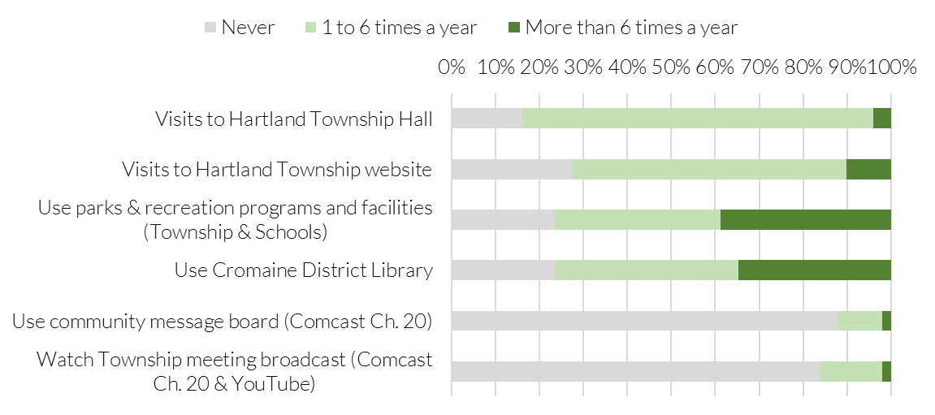
Question 16: Use of community assets

Slide 37
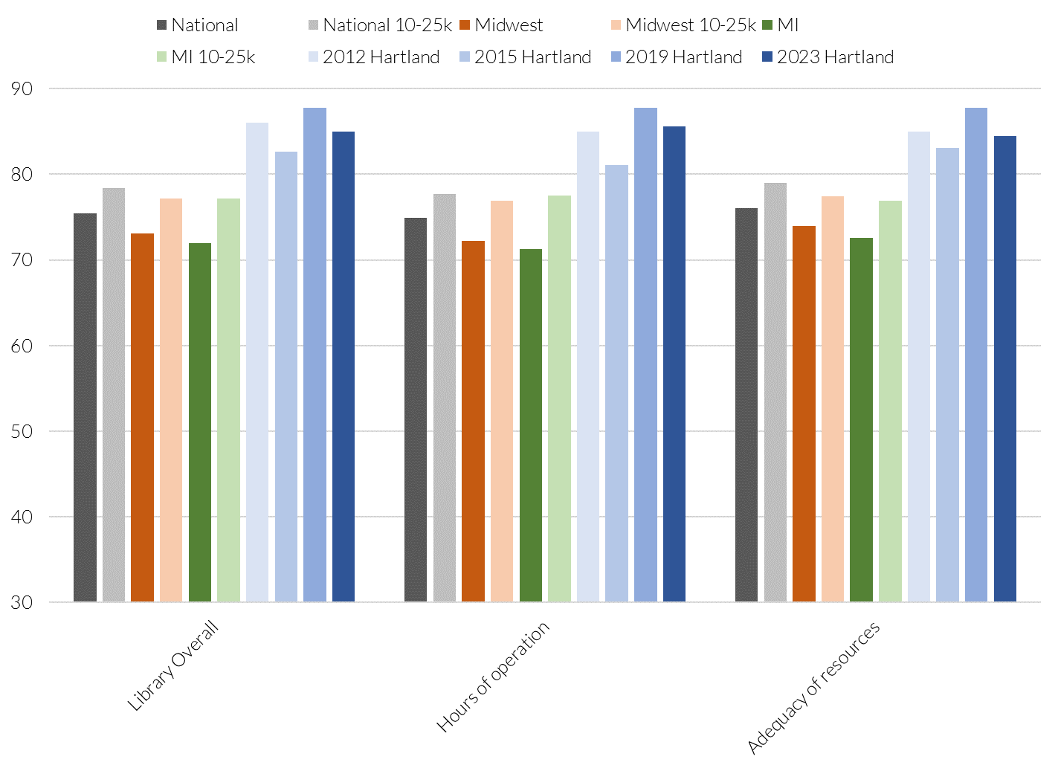
Cromaine District Library

Slide 38
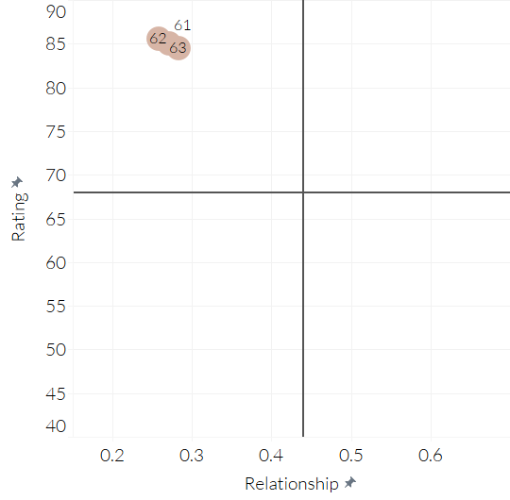
Drivers of Satisfaction and Behavior:
Library
Higher Connection,
Higher Satisfaction
Higher Connection,
Lower Satisfaction

Slide 39
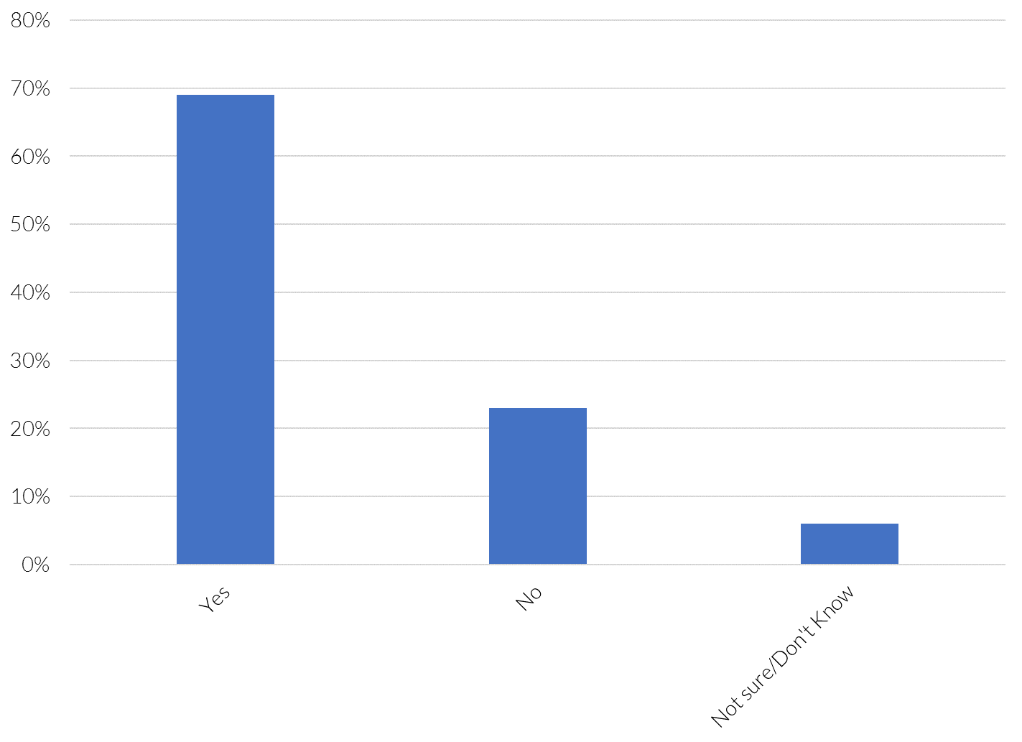
Question 18: Does a member of your household have a current library card?

Slide 40
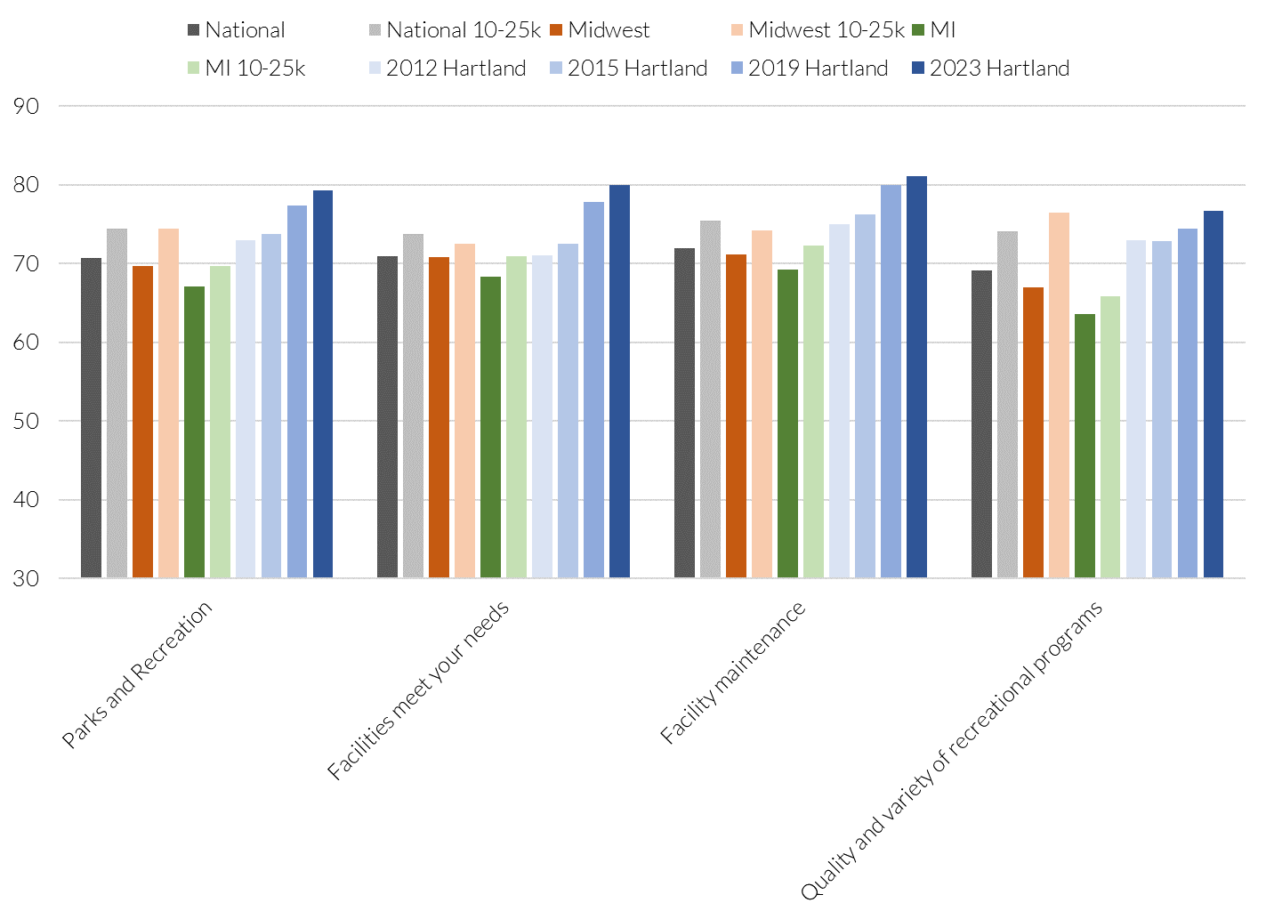
Local Parks and Recreation

Slide 41
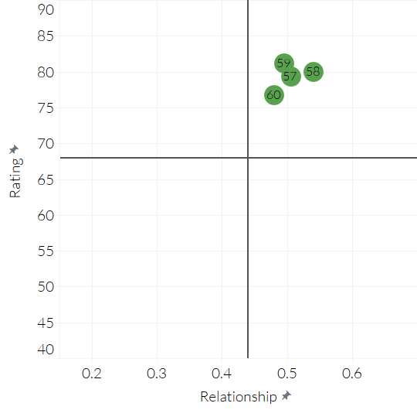
Drivers of Satisfaction and Behavior:
Parks and Recreation
Higher Connection,
Higher Satisfaction
Higher Connection,
Lower Satisfaction

Slide 42
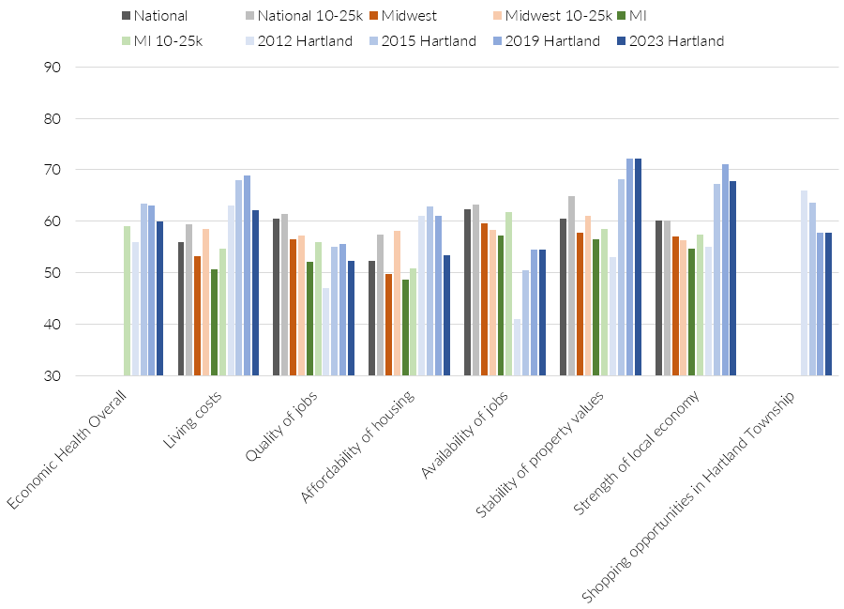
Economic Health

Slide 43
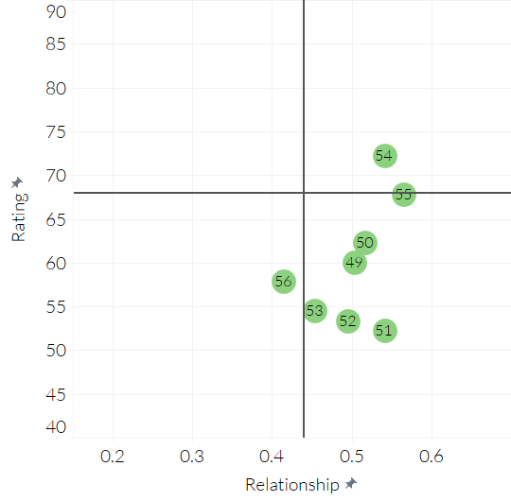
Drivers of Satisfaction and Behavior:
Economic Health
Higher Connection,
Higher Satisfaction
Higher Connection,
Lower Satisfaction

Slide 44
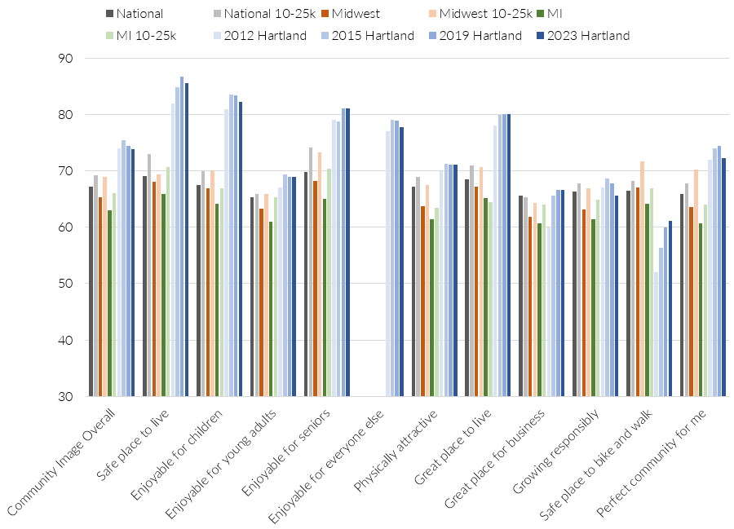
Community Image

Slide 45
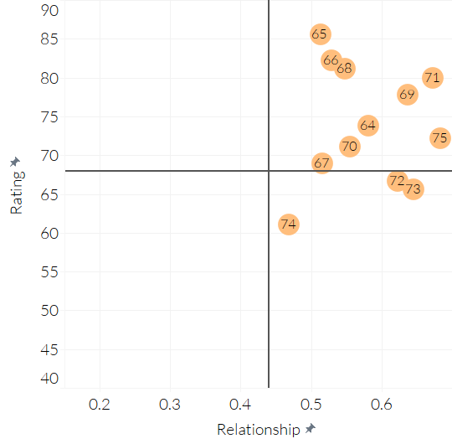
Drivers of Satisfaction and Behavior:
Township Image Overall
Higher Connection,
Higher Satisfaction
Higher Connection,
Lower Satisfaction

Slide 46
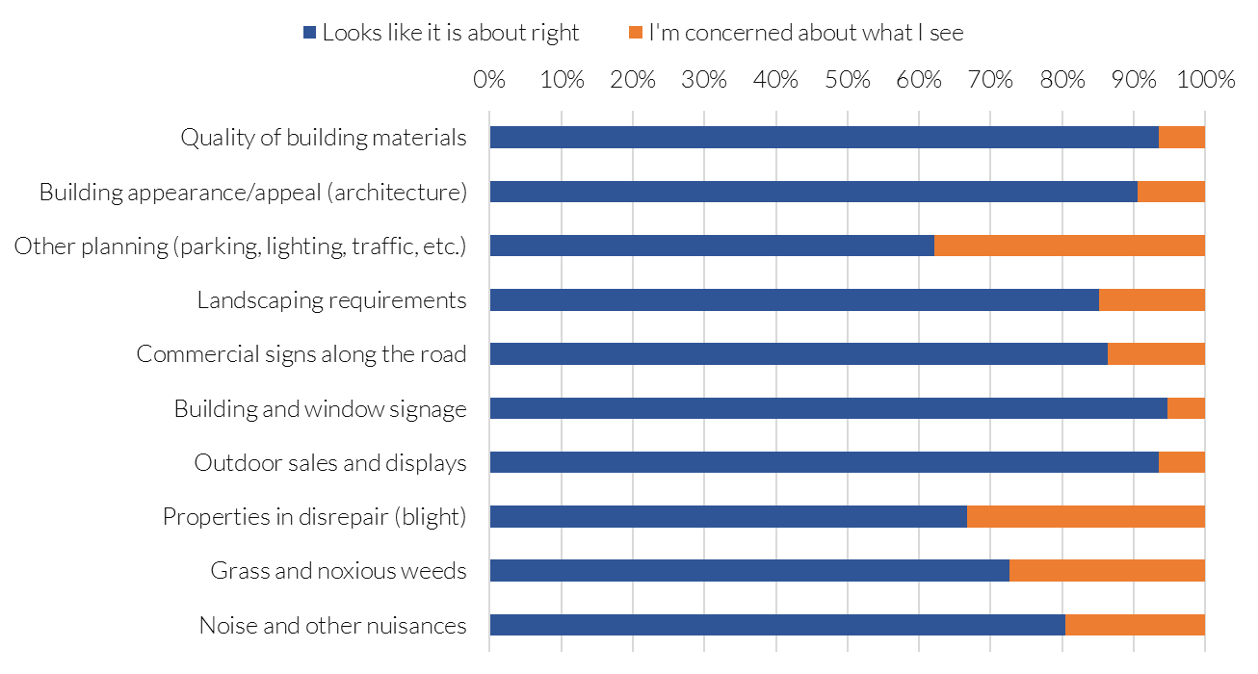
Question 26: Ordinances and Standards

Slide 47
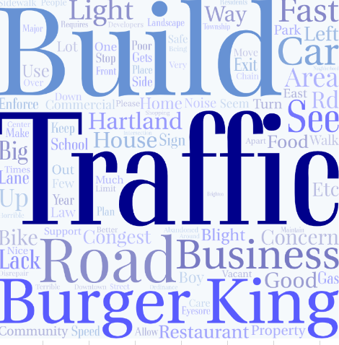
Question 27: Briefly describe your concerns; if any
Top Themes:
1-Build: Some residents don't want any more new buildings and instead would like to see the removal of vacant buildings
2-Traffic: Residents expressed concern over the increased construction work on M-59 and the amount of traffic. They would also like to see more public safety features such as more bike and walking paths
3-Burger King: Residents would like to see the unsightly, abandoned building removed

Slide 48
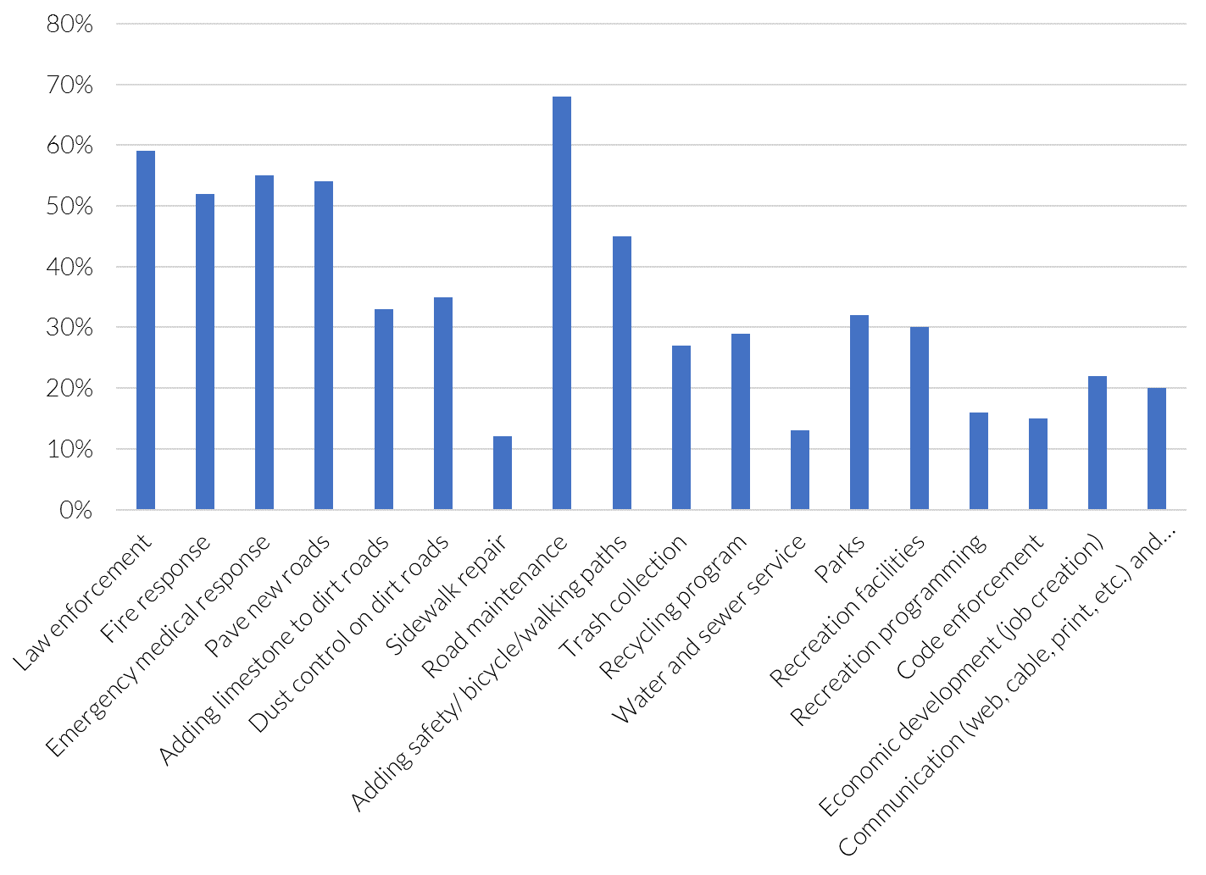
Question 28: Which services should the Township prioritize for funding?

Slide 49
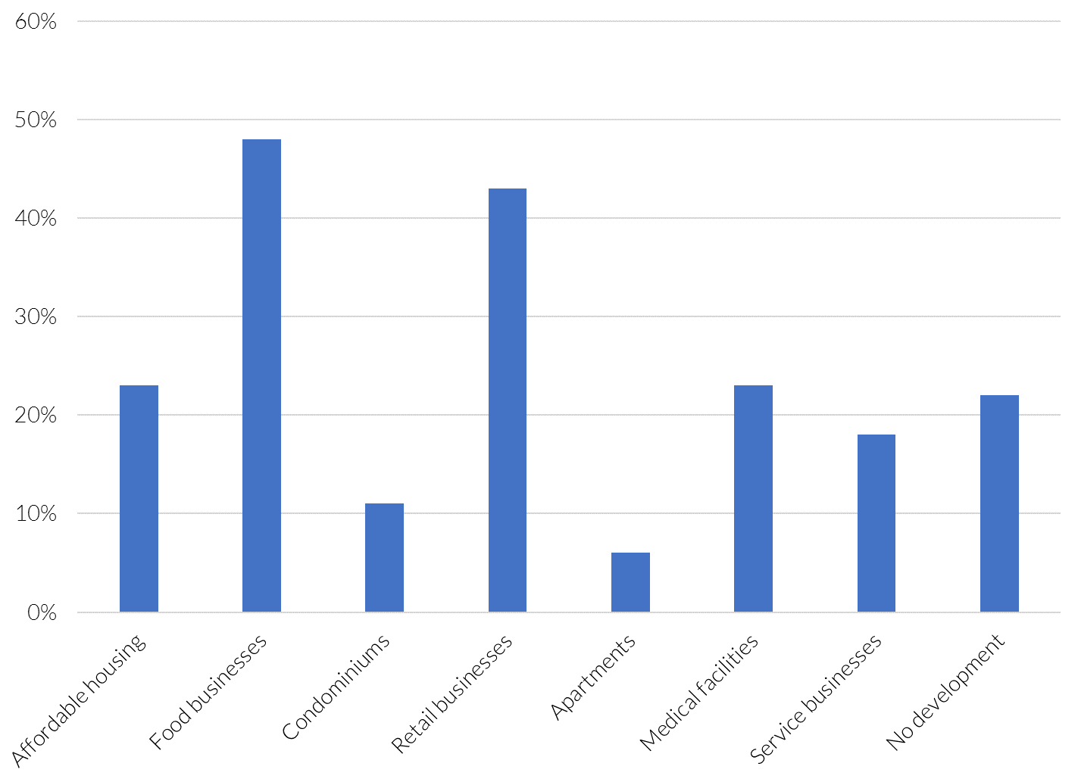
Question 29: Areas for more development

Slide 50

Question 30: Which specific types of housing or businesses would you like to see more of, if any?
Top Themes:
1- Restaurants: Residents want to see more sit-down type/ mom-and-pop places to eat. They do not want more fast food or chain restaurants
2-Homes/Houses: Residents would like to see more affordable housing for single families and elderly
3-Menards: Residents would like a home Improvement store

Slide 51
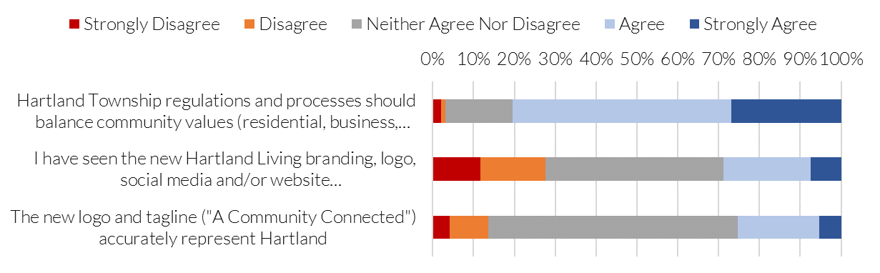
Question 31: Future Options- Level of agreement

Slide 52
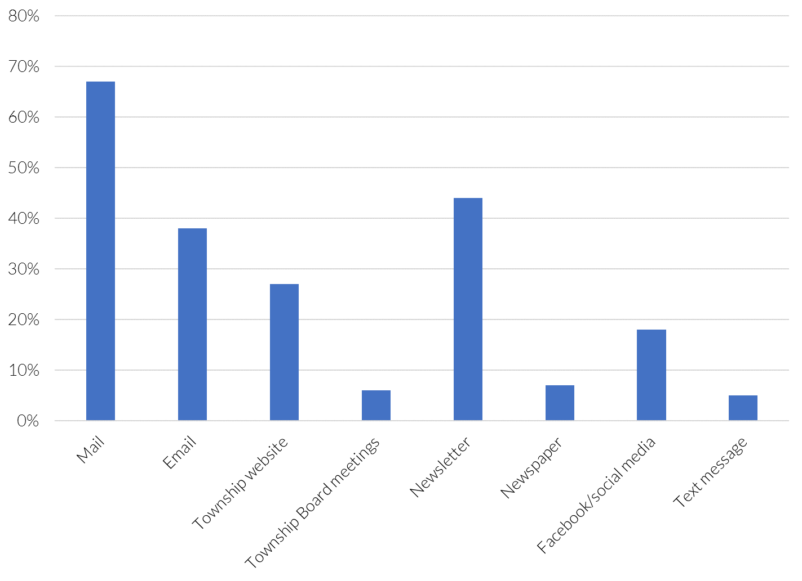
Question 32: How do you receive information from the Township?

Slide 53
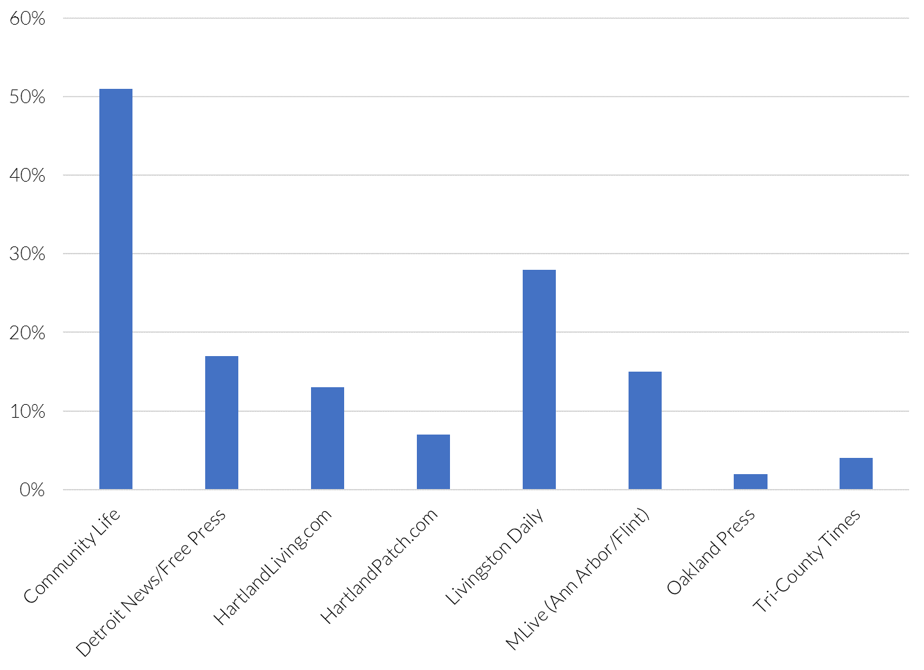
Question 33: Which newspaper or website do you read?

Slide 54
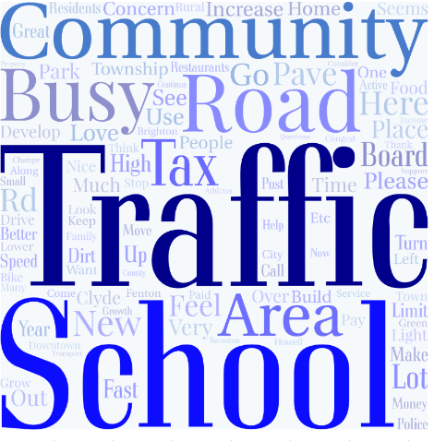
Question 45: Additional Commets
Top Themes:
1- Traffic: Residents are not pleased with the increase in traffic. They also feel that the roads should be better maintained and paved. Some residents would like to see a traffic light study conducted.
2-School: Residents do not like the changes that the school board is making. They feel that the school district is too political.
3-Community: Residents love the rural community feel of Hartland and are concerned with the influx of traffic and new buildings. They are also concerned about the lack of public safety officers.

Slide 55
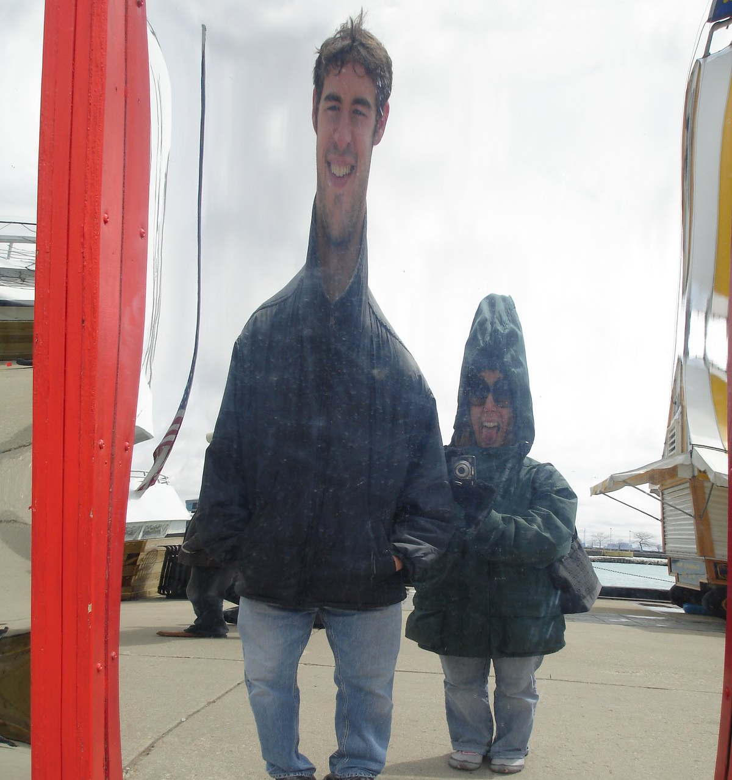
Perception v Reality: Minimize Distortion or Fix Real Performance Issues
Perception gap:
Respondents rated based on an inaccurate idea or understanding. Address with communication strategy to change that perception.
Real performance issue: Address with an improvement plan. When performance improves, it becomes a perception gap to address with a communication strategy.
Notes:
There are two ideas when it comes to the results – is it a perception gap? Or is there a real performance issue?
If there is a perception gap, you want to come up with communication strategies to help change that perception
If there is a real performance gap, you’ll want to come up with an improvement plan to bring performance back up. However, when performance improves, it then shifts to a perception gap – so you’ll need to communicate all of the changes and progress that you have made – otherwise, people are unaware and perceive the performance issues are still there

Slide 56
Strategy is About Action:
Improve Performance to Improve Outcomes
The diagram at the right provides a framework for following up on this survey
  The first step (measurement) is complete. This measurement helps prioritize resources and create a baseline against which progress can be measured.
  The second step is to use internal teams to further analyze the results and form ideas about why respondents answered as they did and potential actions in response.
  The third step is to validate ideas and potential actions through conversations with residents and line staff – do the ideas and actions make sense. Focus groups, short special-topic surveys and benchmarking are helpful.
  The fourth step is to provide staff with the skills and tools to effectively implement the actions.
  The fifth step is to execute the actions.
  The final step is to re-measure to ensure progress was made and track changes in resident needs.
1
Measure
2
Ideas/ Brainstorm
3
Validate/ Confirm
4
Train
5
Implement
Outcomes

Slide 57
Questions

